Slide 1
ANURAG GROUP OF INSTITUTIONS
DEPARTMENT OF COMPUTER SCIENCE ENGINEERING
MAJOR PROJECT
ON
TRACKING OF MEDICINES OVER BLOCKCHAIN
BY:
VUPPULA RAHUL - 17H61A05B8
C.SRI SAI NIKHIL - 17H61A0573
CH.PRASHANTH NAIK - 17H61A0572
UNDER THE GUIDANCE
OF
Mrs.P.Vinayasree, Asst.Prof,
CSE Dept

Slide 2
CONTENTS
Abstract
Motivation
Introduction
Limitations of existing approach
Aims and Objectives
Methodology
Technologies and tools
UML Diagrams
Output screenshots
Conclusion
References

Slide 3
ABSTRACT
At present, in pharmacology one of the most serious problems is counterfeit drugs. The Health Research Funding organization reported that in developing countries, nearly 10–30% of the drugs are fake. Counterfeiting is not the main issue itself, but, rather, the fact that, as compared to traditional drugs, these counterfeit drugs produce different side effects to human health. This is the major worldwide problem, and the situation is worse in developing countries, where one out of every 10 medicines are either fake or do not follow drug regulations. The rise of Internet pharmacies has made it more difficult to standardize drug safety. It is difficult to detect counterfeits because these drugs pass through different complex distributed networks, thus forming opportunities for counterfeits to enter the authentic supply chain. The safety of the pharmaceutical supply chain has become a major concern for public health, which is a collective process. In this, we are using a novel drug supply chain management using Ganache based on blockchain technology to handle secure drug supply chain records. This is like a POC which solves this problem by conducting drug record transactions on a blockchain to create a smart healthcare ecosystem with a drug supply chain.

Slide 4
MOTIVATION
In today’s pharmaceutical supply chain, each transacting party typically manages its own database systems.
So, there is no shared global system of record representing the single source of truth describing the flow of items through the pharmaceutical supply chain which have its own drawbacks.
This leaves the supply chain as a whole more vulnerable to common attack vectors such as man-in-the-middle or spoofing of the medicines which may cause severe side effects.

Slide 5
INTRODUCTION
Blockchain is a tamper-proof, timestamped, auditable record of transactions, which makes it possible to enhance privacy and security across a range of collaborative applications. Unlike a centralized relational database, no single user or organization can access the full record of transactions.
This way of approach is particularly important in the pharmaceutical supply chain to reveal the possible instances of counterfeiting, diversion, spoofing of medicines.
In this way blockchain can be potential honest platform that would allow hundreds of competing pharmaceutical and biotech enterprises to work collaboratively and communicate with hundreds of wholesalers.

Slide 6
LIMITATIONS OF EXISTING APPROACH
Traceability
Expiration
Slow process and error prone paperwork
Mutable and invalid source
Lack of co-ordination

Slide 7
AIMS AND OBJECTIVES
Accurate information across the entire chain at any point of time and at any location is provided.
Product Authentication
Traceability back to source of all materials.
Decentralized database that allow different parties to share information with each other without requiring a central administrator
Reduced paper work and Speedup process

Slide 8
METHODOLOGY
Ganache is a personal blockchain for rapid Ethereum distributed application development. You can use Ganache across the entire development cycle; enabling you to develop, deploy, and test your dApps in a safe and deterministic environment.
We create and integrate a local blockchain(by Ganache) then link the Ethereum wallet to the application using MetaMask, so it forms a transaction bridge.This involves ordering of transactions or of medication.
Solidity’s code is encapsulated in contracts which means a contract in Solidity is a collection of code (its functions) and data (its state) that resides at a specific address on the Ethereum blockchain. A contract is a fundamental block of building an application on the Ethereum.

Slide 9
TECHNOLOGIES AND TOOLS
Ganache (Personal Blockchain)
Metamask
Node Js
Solidity (Ethereum's smart contract programming language)
web3.js (Javascript library used to interact with the Ethereum blockchain)
Xampp(Local Server)

Slide 10
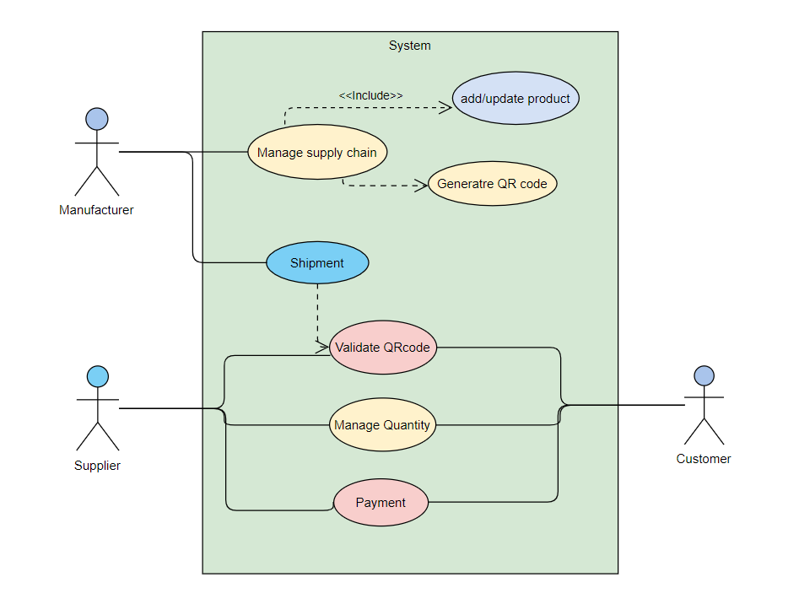
USECASE DIAGRAM

Slide 11
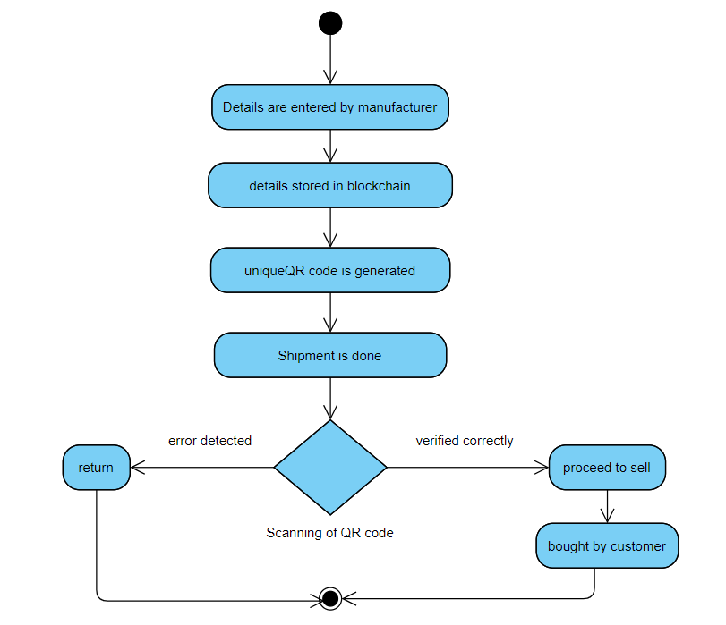
Activity diagram

Slide 12
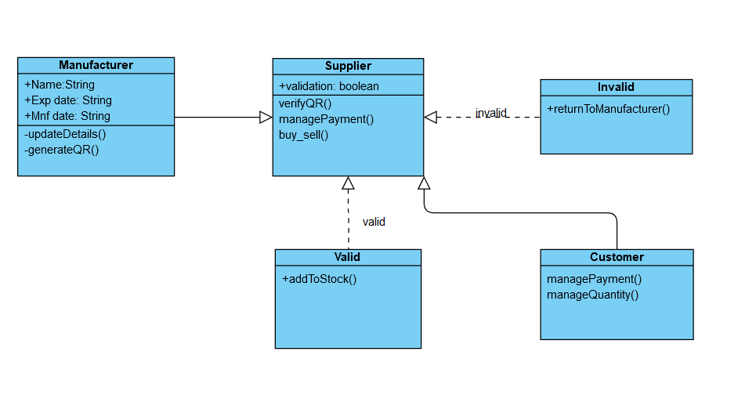
CLASS DIAGRAM

Slide 13
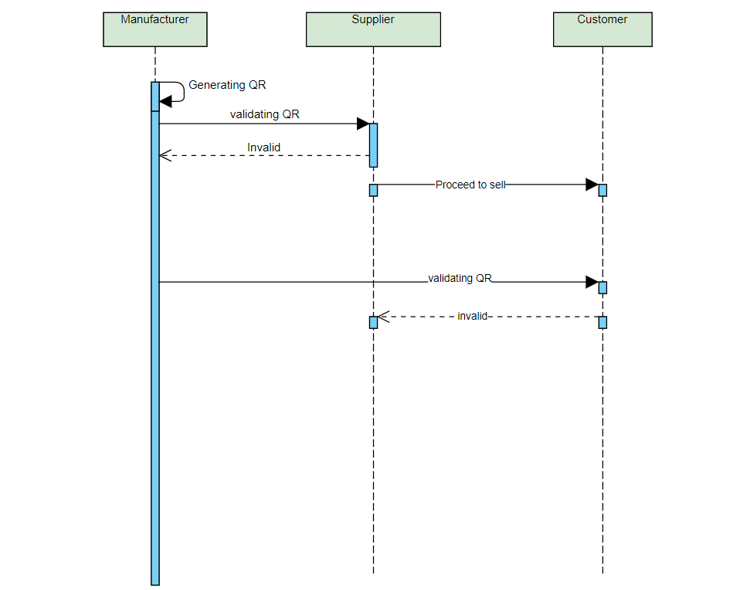
SEQUENCE DIAGRAM

Slide 14
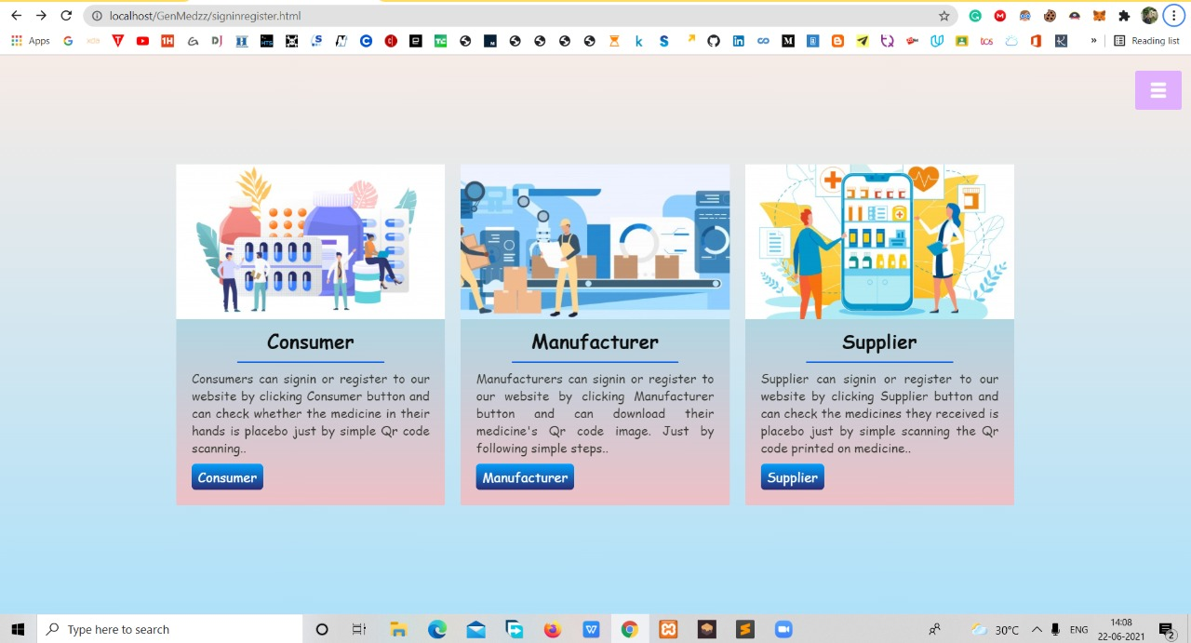
OUTPUT SCREENSHOTS

Slide 15
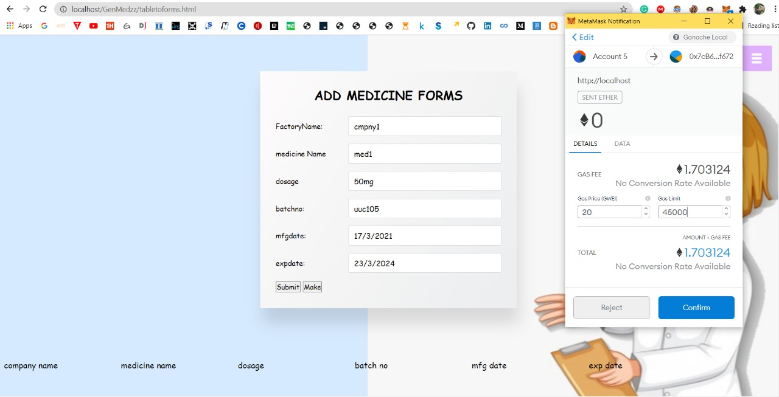
Manufacturer adding medicine and making Ethereum payment via metamask

Slide 16
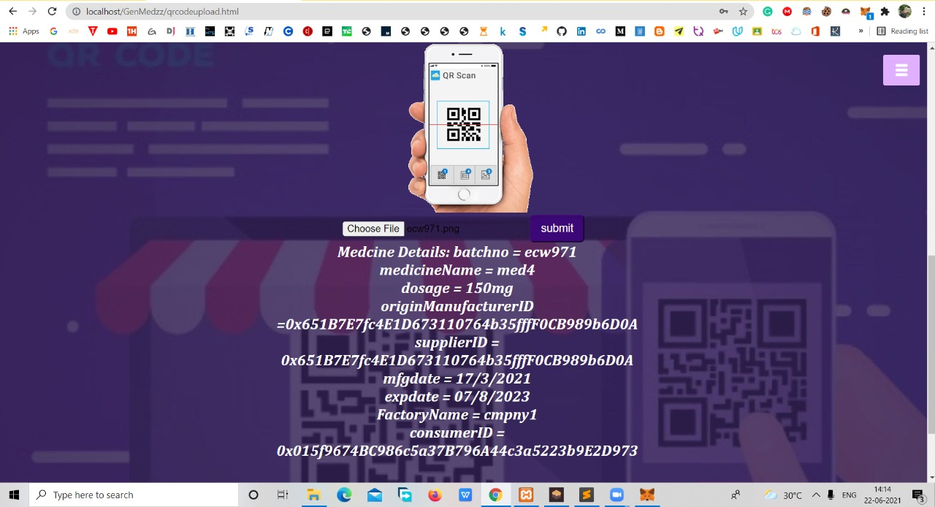
Supplier validating the details

Slide 17
CONCLUSION
It is a fact that healthcare at present need to have more attention to secure of the medicines and they need to make sure that their medicines are used in a authentic way, blockchain in healthcare is near future. Managing electronic health records in blockchain could have few focal points.
A potential assistance of blockchain for researchers is that it could provide verified and timestamped versions of scientific studies. Just like the smart contracts allow patients to control their data, a documentation blockchain record would allow researchers to have a sustainable history of their findings. In the giant field of the pharmaceutical industry, blockchain is a must-have technology.

Slide 18
REFERENCES
Kuo, T.-T.; Kim, H.; Ohno-Machado, L. Blockchain distributed ledger technologies for biomedical and healthcare applications.
Angraal, S.; Krumholz, H.M.; Schulz, W.L. Blockchain technology: Applications in health care.Circ. Cardiovasc
Xia, Q.; Sifah, E.B.; Asamoah, K.O.; Gao, J.; Du, X.; Guizani, M. MeDShare: Trust-less medical data sharingamong cloud service providers via blockchain. IEEE

Slide 19
THANK-YOU

